Slide 1


Graph Algorithms

Slide 2
Graphs
Graph G = (V, E)
» V = set of vertices
» E = set of edges ⊆ (V×V)
Types of graphs
» Undirected: edge (u, v) = (v, u); for all v, (v, v) ∉ E (No self
loops.)
» Directed: (u, v) is edge from u to v, denoted as u → v. Self loops are allowed.
» Weighted: each edge has an associated weight, given by a weight
function w : E → R.
» Dense: |E| ≈ |V|².
» Sparse: |E| << |V|².
⬥ |E| = O(|V|²)

Slide 3
Graphs
If (u, v) ∈ E, then vertex v is adjacent to vertex u.
Adjacency relationship is:
» Symmetric if G is undirected.
» Not necessarily so if G is directed.
If G is connected:
» There is a path between every pair of vertices.
» |E| ≥ |V| – 1.
» Furthermore, if |E| = |V| – 1, then G is a tree.

Slide 4
Representation of Graphs
Two standard ways.
» Adjacency Lists.
a b
a
b c d
b
d
c
a
c
c
d
d
a
b
a
c
» Adjacency Matrix.
1 2
a b
 | 1 | 2 | 3 | 4
1 | 0 | 1 | 1 | 1
2 | 1 | 0 | 1 | 0
3 | 1 | 1 | 0 | 1
c
d
3
4
4 1 0 1 0

Slide 5
Adjacency Lists
Consists of an array Adj of |V| lists.
One list per vertex.
For u ∈ V, Adj[u] consists of all vertices adjacent to u.
a b
a
b c d
b d c
c
If weighted, store weights also in adjacency lists.
c
d
d
a
b
a
b c d
b
d
c
a
c
c
d
d
a
b
a
c

Slide 6
Storage Requirement
For directed graphs:
» Sum of lengths of all adj. lists is
∑out-degree(v) = |E|
v∈V
No. of edges leaving v
» Total storage: Θ(V+E)
For undirected graphs:
» Sum of lengths of all adj. lists is
∑degree(v) = 2|E|
v∈V
No. of edges incident on v. Edge (u,v) is incident
on vertices u and v.
» Total storage: Θ(V+E)

Slide 7
Pros and Cons: adj list
Pros
» Space-efficient, when a graph is sparse.
» Can be modified to support many graph variants.
Cons
» Determining if an edge (u,v) ∈G is not efficient.
Have to search in u’s adjacency list. Θ(degree(u)) time.
Θ(V) in the worst case.

Slide 8
Adjacency Matrix
|V| × |V| matrix A.
Number vertices from 1 to |V| in some arbitrary manner.
A is then given by:
⎧1 if (i, j) ∈ E
⎩0 otherwise
A[i, j] = a_{ij} = ⎨
1
2
a
b
 | 1 | 2 | 3 | 4
1 | 0 | 1 | 1 | 1
2 | 0 | 0 | 1 | 0
3 | 0 | 0 | 0 | 1
4 | 0 | 0 | 0 | 0
 | 1 | 2 | 3 | 4
1 | 0 | 1 | 1 | 1
2 | 1 | 0 | 1 | 0
3 | 1 | 1 | 0 | 1
4 | 1 | 0 | 1 | 0
c
d
4
3
1
2
a
b
A = A^{T} for undirected graphs.
c
d
3
4

Slide 9
Space and Time
Space: Θ(V²).
» Not memory efficient for large graphs.
Time: to list all vertices adjacent to u: Θ(V).
Time: to determine if (u, v) ∈ E: Θ(1).
Can store weights instead of bits for weighted graph.

Slide 10
Graph-searching Algorithms
Searching a graph:
» Systematically follow the edges of a graph to visit the vertices of the graph.
Used to discover the structure of a graph.
Standard graph-searching algorithms.
» Breadth-first Search (BFS).
» Depth-first Search (DFS).

Slide 11
Breadth-first Search
Input: Graph G = (V, E), either directed or undirected, and source vertex s ∈ V.
Output:
» d[v] = distance (smallest # of edges, or shortest path) from s to v, for all v ∈ V. d[v] = ∞ if v is not reachable from s.
» π[v] = u such that (u, v) is last edge on shortest path s v.
u is v’s predecessor.
» Builds breadth-first tree with root s that contains all reachable vertices.
Definitions:
Path between vertices u and v: Sequence of vertices (v₁, v₂, …, v_{k}) such that
u=v₁ and v =v_{k}, and (v_{i},v_{i+1}) ∈ E, for all 1≤ i ≤ k-1. Length of the path: Number of edges in the path. Path is simple if no vertex is repeated.
Error!

Slide 12
Breadth-first Search
Expands the frontier between discovered and undiscovered vertices uniformly across the breadth of the frontier.
» A vertex is “discovered” the first time it is encountered during the search.
» A vertex is “finished” if all vertices adjacent to it have been
discovered.
Colors the vertices to keep track of progress.
» White – Undiscovered.
» Gray – Discovered but not finished.
» Black – Finished.
Colors are required only to reason about the algorithm. Can be implemented without colors.

Slide 13
BFS(G,s)
1. for each vertex u in V[G] – {s}
2 do color[u] ← white 3 d[u] ← ∝
π[u] ← nil
color[s] ← gray 6 d[s] ← 0
7 π[s] ← nil
8 Q ← Φ
9 enqueue(Q,s) 10 while Q ≠ Φ
do u ← dequeue(Q)
for each v in Adj[u]
do if color[v] = white
then color[v] ← gray
15 d[v] ← d[u] + 1
16 π[v] ← u
enqueue(Q,v)
color[u] ← black
white: undiscovered gray: discovered black: finished
Q: a queue of discovered vertices
color[v]: color of v
d[v]: distance from s to v
π[u]: predecessor of v
Example: animation.

Slide 14
Example (BFS)
r
∞
s
0
t
∞
u
∞
∞
v
∞
w
∞
x
∞
y
Q: s 0

Slide 15
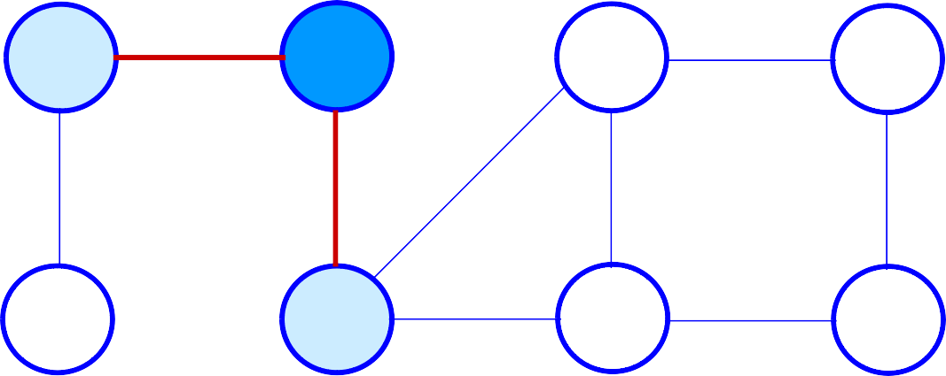
Example (BFS)
r
1
s
0
t
∞
u
∞
∞
v
1
w
∞
x
∞
y
Q: w r
1 1

Slide 16
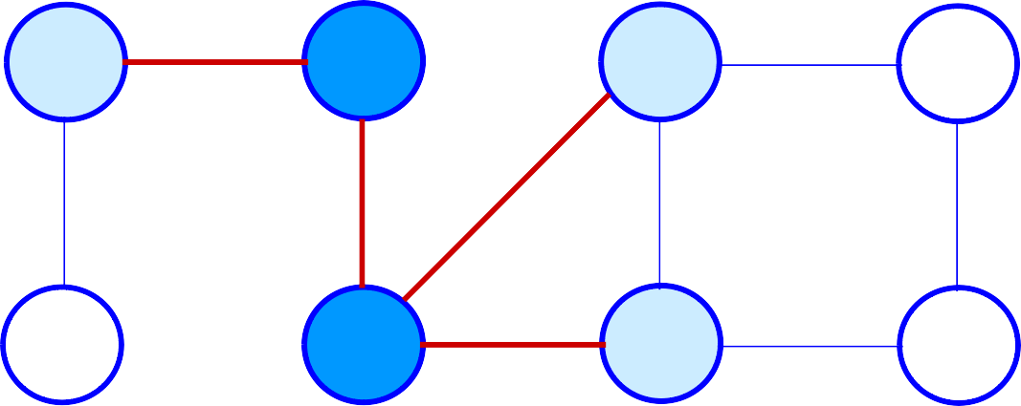
Example (BFS)
r
1
s
0
t
2
u
∞
∞
v
1
w
2
x
∞
y
Q: r t x
1 2 2

Slide 17
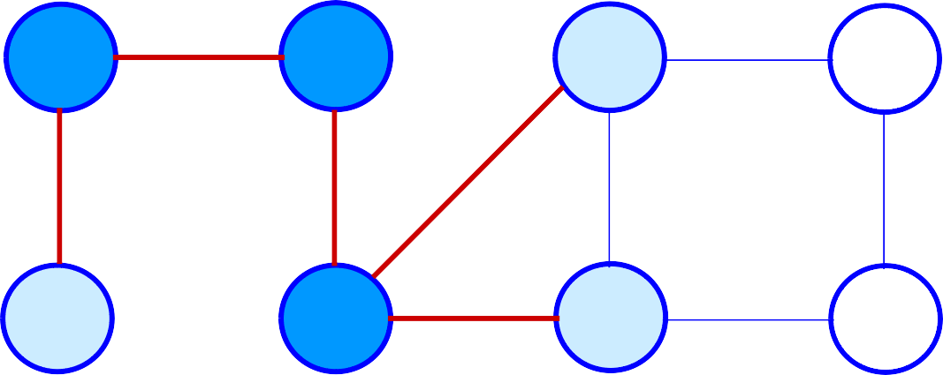
Example (BFS)
r
1
s
0
t
2
u
∞
2
v
1
w
2
x
∞
y
Q: t x v
2 2 2

Slide 18
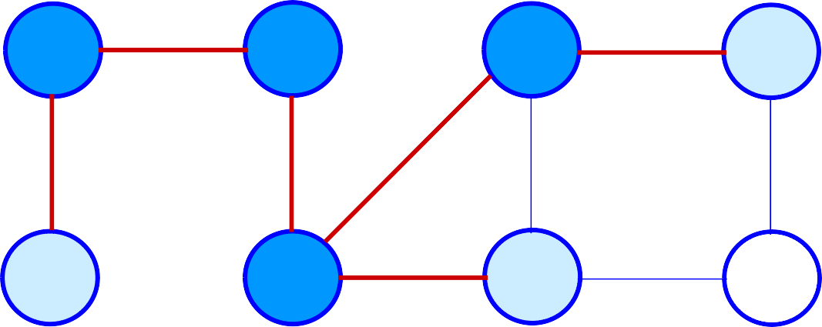
Example (BFS)
r
1
s
0
t
2
u
3
2
v
1
w
2
x
∞
y
Q: x v u
2 2 3

Slide 19
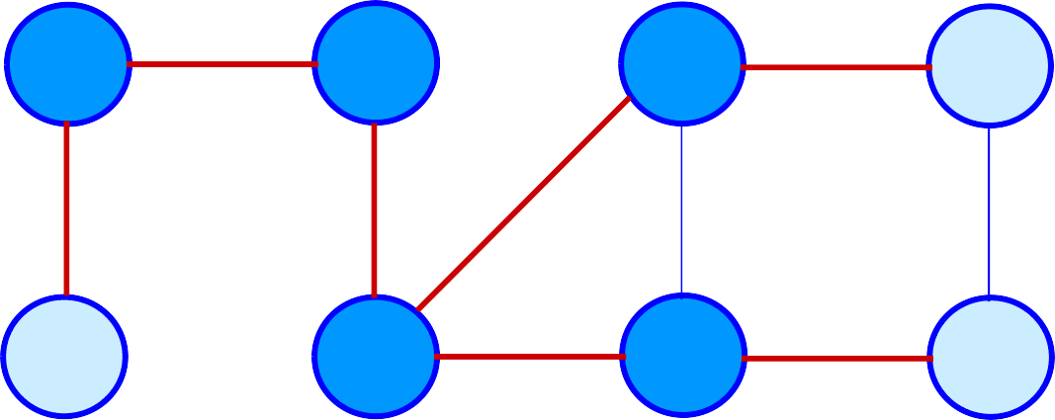
Example (BFS)
r
1
s
0
t
2
u
3
2
v
1
w
2
x
3
y
Q: v u y
2 3 3

Slide 20
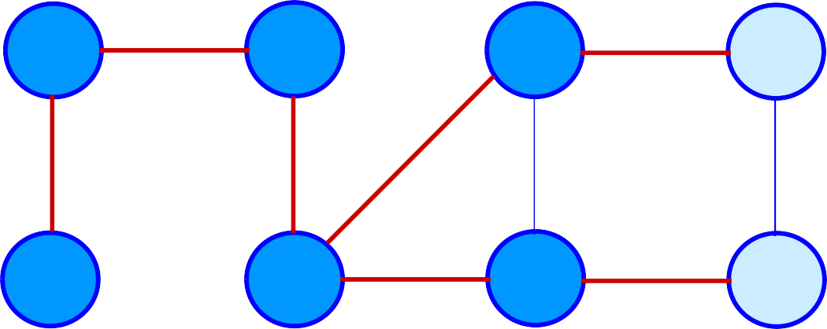
Example (BFS)
r
1
s
0
t
2
u
3
2
v
1
w
2
x
3
y
Q: u y
3 3

Slide 21
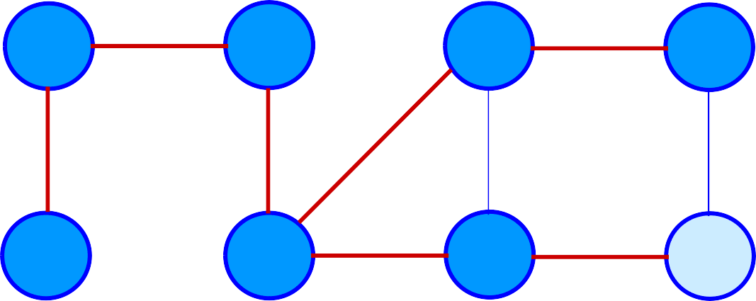
Example (BFS)
r
1
s
0
t
2
u
3
2
v
1
w
2
x
3
y
Q: y 3

Slide 22
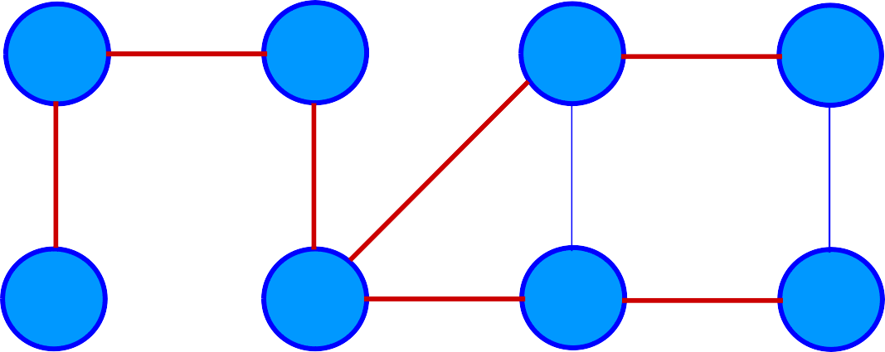
Example (BFS)
r
1
s
0
t
2
u
3
2
v
1
w
2
x
3
y
Q: ∅

Slide 23
Example (BFS)
r
1
s
0
t
2
u
3
2
v
1
w
2
x
3
y
BF Tree

Slide 24
Analysis of BFS
Initialization takes O(V).
Traversal Loop
» After initialization, each vertex is enqueued and dequeued at most once, and each operation takes O(1). So, total time for queuing is O(V).
» The adjacency list of each vertex is scanned at most once. The
sum of lengths of all adjacency lists is Θ(E).
Summing up over all vertices => total running time of BFS is O(V+E), linear in the size of the adjacency list representation of graph.
Correctness Proof
» We omit for BFS and DFS.
» Will do for later algorithms.

Slide 25
Breadth-first Tree
For a graph G = (V, E) with source s, the predecessor subgraph of G is G_{π} = (V_{π} , E_{π}) where
» V_{π} ={v∈V : π[v] ≠ NIL}{s}
» E_{π} ={(π[v],v)∈E : v ∈ V_{π} - {s}}
The predecessor subgraph G_{π} is a breadth-first tree
if:
» V_{π} consists of the vertices reachable from s and
» for all v∈V_{π} , there is a unique simple path from s to v in G_{π}
that is also a shortest path from s to v in G.
The edges in E_{π} are called tree edges.
|E_{π} | = |V_{π} | - 1.

Slide 26
Depth-first Search (DFS)
Explore edges out of the most recently discovered
vertex v.
When all edges of v have been explored, backtrack to explore other edges leaving the vertex from which v was discovered (its predecessor).
“Search as deep as possible first.”
Continue until all vertices reachable from the original source are discovered.
If any undiscovered vertices remain, then one of them is chosen as a new source and search is repeated from that source.

Slide 27
Depth-first Search
Input: G = (V, E), directed or undirected. No source vertex given!
Output:
» 2 timestamps on each vertex. Integers between 1 and 2|V|.
d[v] = discovery time (v turns from white to gray)
f [v] = finishing time (v turns from gray to black)
» π[v] : predecessor of v = u, such that v was discovered during the scan of u’s adjacency list.
Uses the same coloring scheme for vertices as BFS.

Slide 28




Pseudo-code
DFS(G)
for each vertex u ∈ V[G]
do color[u] ← white
π[u] ← NIL
time ← 0
for each vertex u ∈ V[G]
DFS-Visit(u)
color[u] ← GRAY ∇ White vertex u
has been discovered
time ← time + 1
d[u] ← time
for each v ∈ Adj[u]
do if color[v] = WHITE
then π[v] ← u
DFS-Visit(v)
color[u] ← BLACK ∇ Blacken u; it is finished.
f[u] ← time ← time + 1
6.
7.
do if color[u] = white
then DFS-Visit(u)
Uses a global timestamp time.
9.
Example: animation.

Slide 29
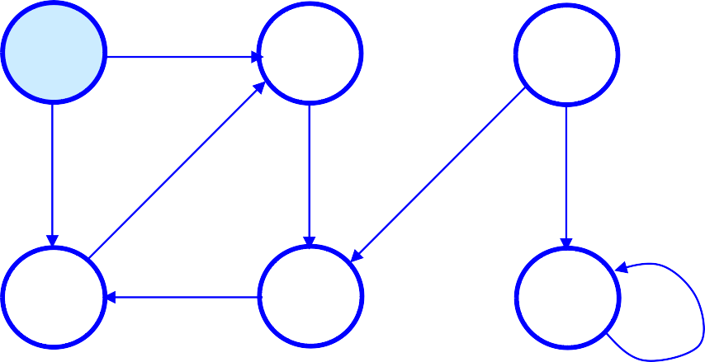
Example (DFS)
u
1/
v
w
x
y
z

Slide 30
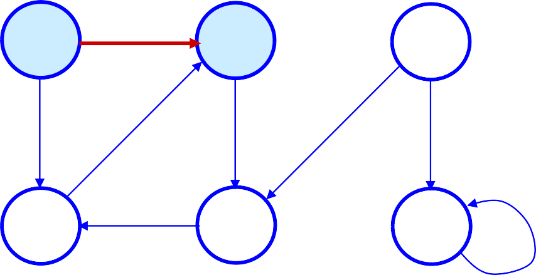
Example (DFS)
u | v | W
1/ | 2/
x
y
z

Slide 31
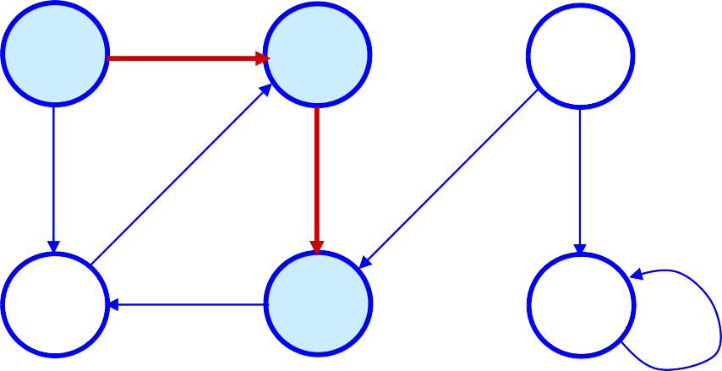
Example (DFS)
u
1/
v
2/
w
3/
y
x
z

Slide 32
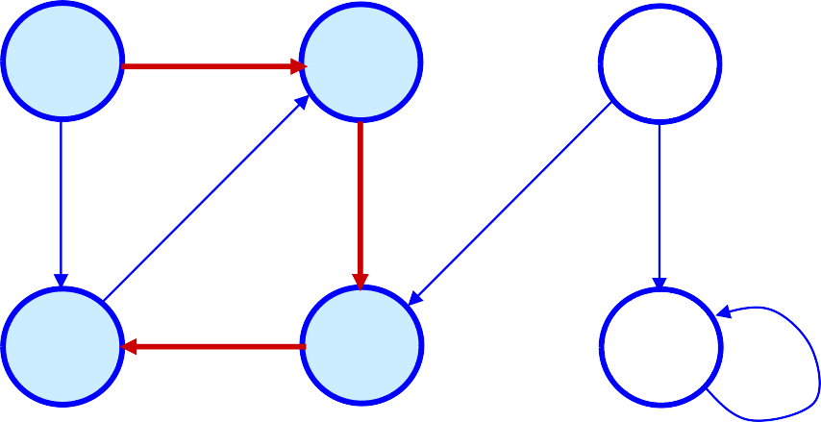
Example (DFS)
u
1/
v
2/
w
4/ | 3/
X | Y | z

Slide 33
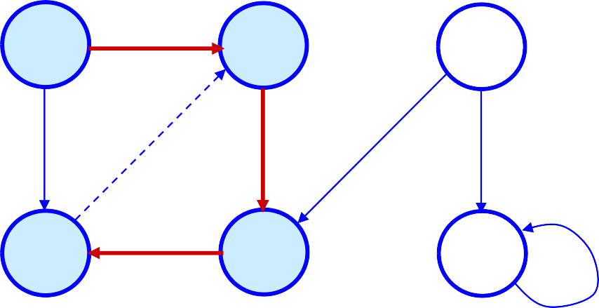
Example (DFS)
u
1/
v
2/
w
B
4/
x
3/
y
z

Slide 34
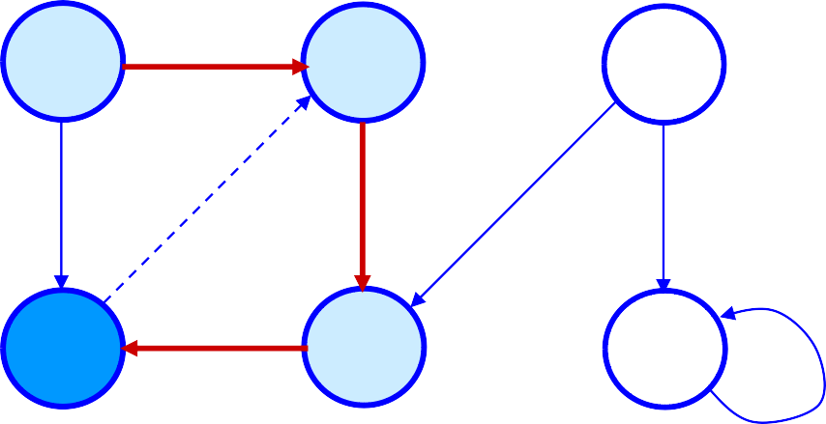
Example (DFS)
u
1/
v
2/
w
B
4/5
x
3/
y
z

Slide 35
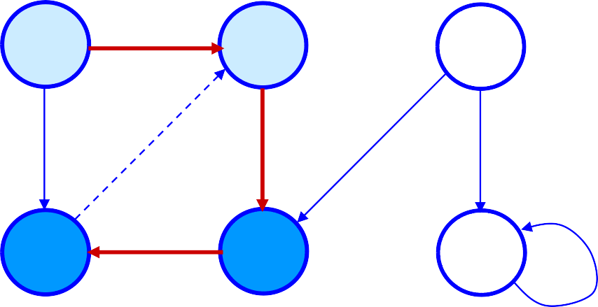
Example (DFS)
u
1/
v
2/
w
B
4/5
x
3/6
y
z

Slide 36
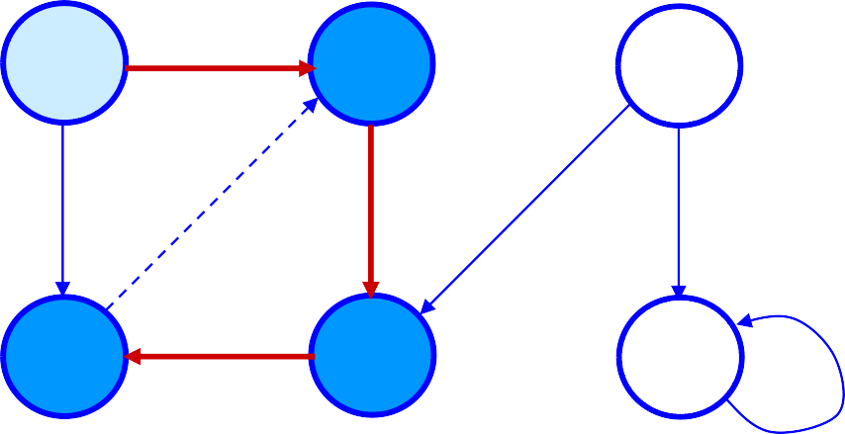
Example (DFS)
u
1/
v
2/7
w
B
4/5
x
3/6
y
z

Slide 37

Example (DFS)
u
1/
v
2/7
w
F
B
4/5
x
3/6
y
z

Slide 38
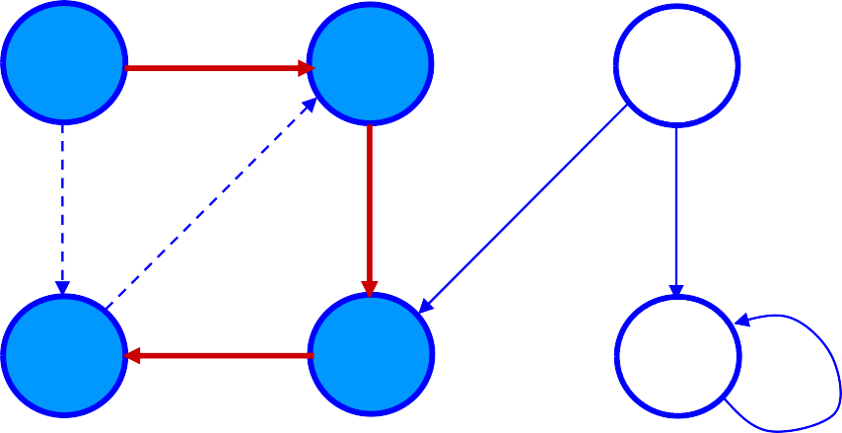
Example (DFS)
u
1/8
v
2/7
w
F
B
4/5
x
3/6
y
z

Slide 39
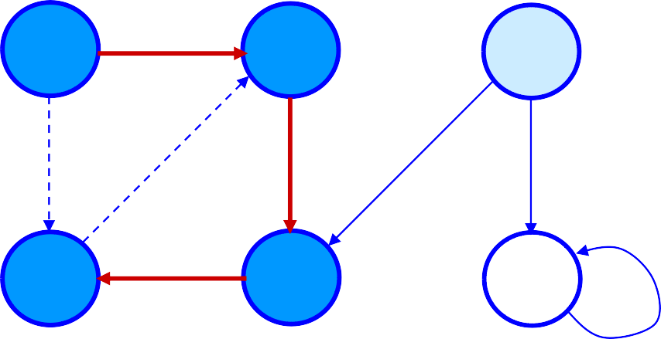
Example (DFS)
u
1/8
v
2/7
w
9/
F
B
4/5
x
3/6
y
z

Slide 40
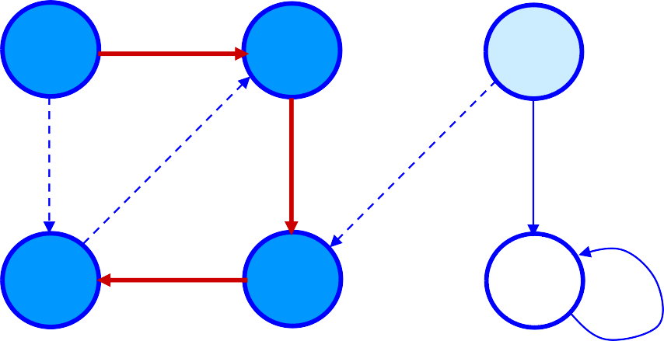
Example (DFS)
u
1/8
v
2/7
w
9/
F
B
C
4/5
x
3/6
y
z

Slide 41
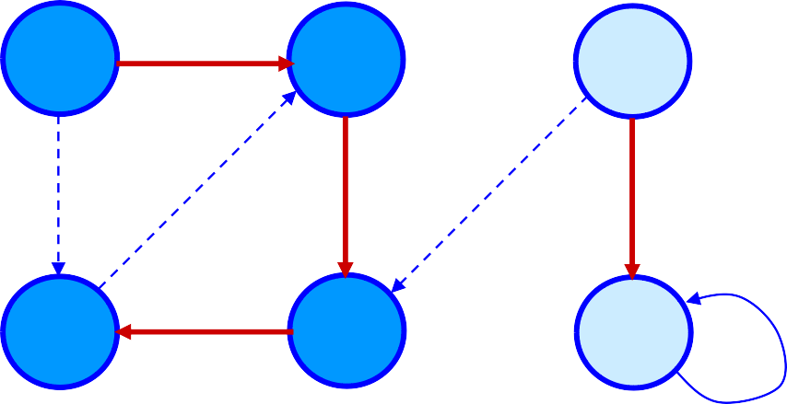
Example (DFS)
u
1/8
v
2/7
w
9/
F
B
C
4/5
x
3/6
y
10/
z

Slide 42
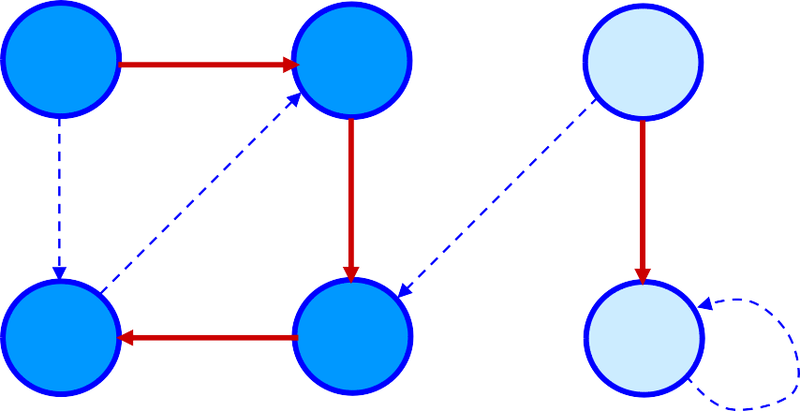
Example (DFS)
u
1/8
v
2/7
w
9/
F
B
C
4/5
x
3/6
y
10/
z
B

Slide 43
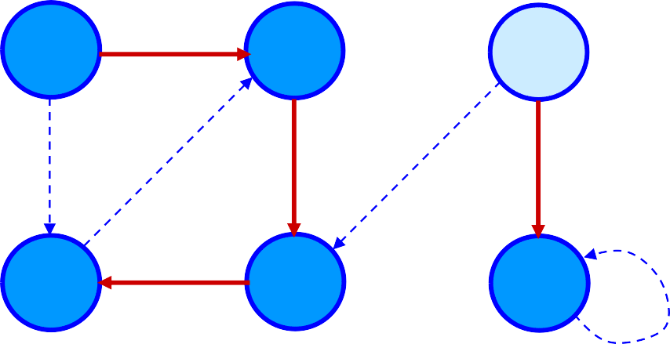
Example (DFS)
u
1/8
v
2/7
w
9/
F
B
C
4/5
x
3/6
y
10/11
z
B

Slide 44
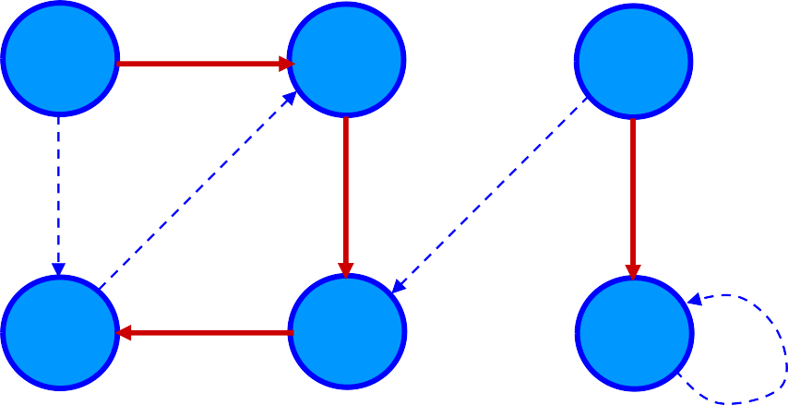
Example (DFS)
u
1/8
v
2/7
w
9/12
F
B
C
4/5
x
3/6
y
10/11
z
B

Slide 45
Analysis of DFS
Loops on lines 1-2 & 5-7 take Θ(V) time, excluding time
to execute DFS-Visit.
DFS-Visit is called once for each white vertex v∈V when it’s painted gray the first time. Lines 3-6 of DFS- Visit is executed |Adj[v]| times. The total cost of executing DFS-Visit is ∑_{v∈V}|Adj[v]| = Θ(E)
Total running time of DFS is Θ(V+E).

Slide 46


Parenthesis Theorem
Theorem 22.7
For all u, v, exactly one of the following holds:
d[u] < f [u] < d[v] < f [v] or d[v] < f [v] < d[u] < f [u] and neither u
nor v is a descendant of the other.
d[u] < d[v] < f [v] < f [u] and v is a descendant of u.
d[v] < d[u] < f [u] < f [v] and u is a descendant of v.
So d[u] < d[v] < f [u] < f [v] cannot happen.
Like parentheses:
⬥ OK: ( ) [ ] ( [ ] ) [ ( ) ]
⬥ Not OK: ( [ ) ] [ ( ] )
Corollary
v is a proper descendant of u if and only if d[u] < d[v] < f [v] < f [u].

Slide 47
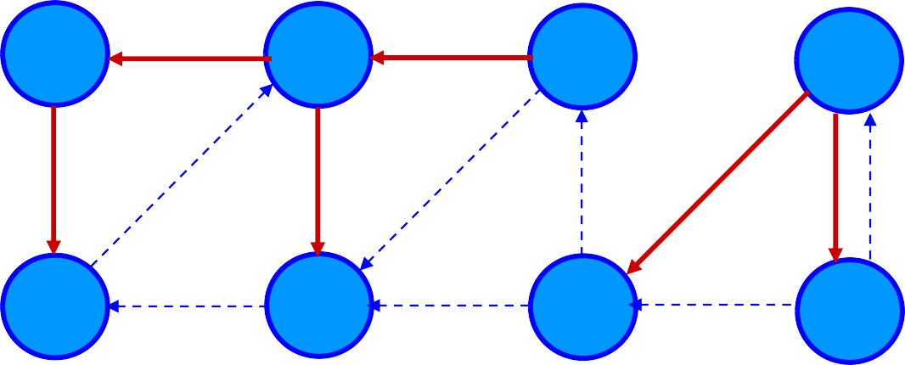
Example (Parenthesis Theorem)
y
3/6
z
2/9
s
1/10
t
11/16
B
F
C
B
4/5
x
7/8
w
12/13
v
14/15
u
C
C
C
(s (z (y (x x) y) (w w) z) s) (t (v v) (u u) t)

Slide 48
Depth-First Trees
Predecessor subgraph defined slightly different from that of BFS.
The predecessor subgraph of DFS is G_{π} = (V, E_{π}) where
E_{π} ={(π[v],v) : v ∈ V and π[v] ≠ NIL}.
» How does it differ from that of BFS?
» The predecessor subgraph G_{π} forms a depth-first forest composed of several depth-first trees. The edges in E_{π} are called tree edges.
Definition:
Forest: An acyclic graph G that may be disconnected.

Slide 49


White-path Theorem
Theorem 22.9
v is a descendant of u if and only if at time d[u], there is a
path
u v consisting of only white vertices. (Except for u, which was
just colored gray.)

Slide 50


Classification of Edges
Tree edge: in the depth-first forest. Found by exploring
(u, v).
Back edge: (u, v), where u is a descendant of v (in the depth-first tree).
Forward edge: (u, v), where v is a descendant of u, but
not a tree edge.
Cross edge: any other edge. Can go between vertices in same depth-first tree or in different depth-first trees.
Theorem:
In DFS of an undirected graph, we get only tree and back edges. No forward or cross edges.

